Slide 1
What is the Thing You Regret the Most?
Do we have a choice?

Slide 2
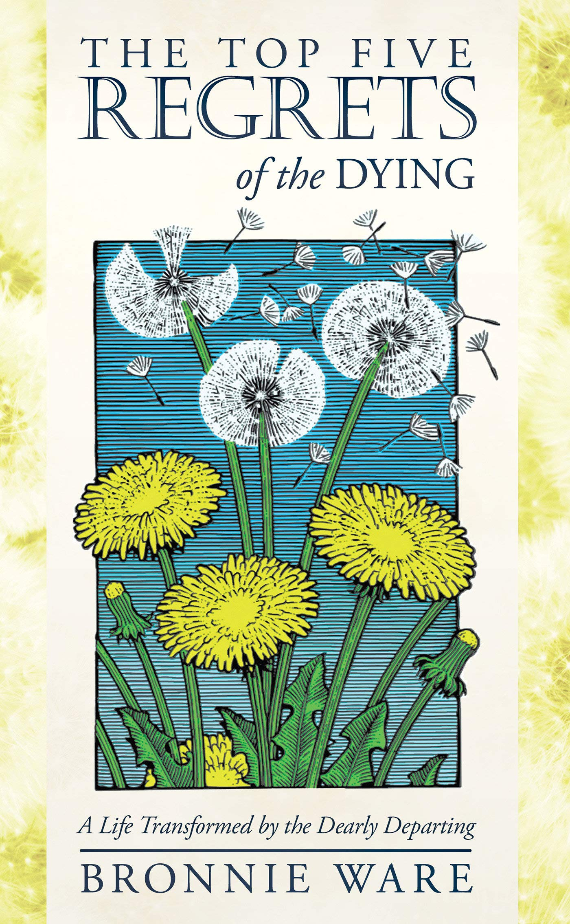
A palliative nurse, Bronnie Ware, after caring for thousands of patients at the end of their lives, revealed the top five regrets of the dying:
I wish I'd had the courage to live a life true to myself.
I wish I hadn't worked so hard.
I wish I'd had the courage to express my feelings.
I wish I had stayed in touch with my friends.
I wish that I had let myself be happier.

Slide 3
foreign talent
A person's greatest freedom is not to do what he/she wants, it is
having the courage to say “no”, when you don't want to do something.— Lung Ying-tai
Financial
TimE
Freedom
Notes:
Consider talking about:
Additional solo flights

Slide 4
Time & Financial Freedom
Tickets
→ Partners
→ Team
→ Leader
+Leader→
Ongoing Income
↓

Slide 5
People who are better than you are working harder than you
Choice
Is More Important than Effort?!
Buying and Selling Tickets

